Slide 1

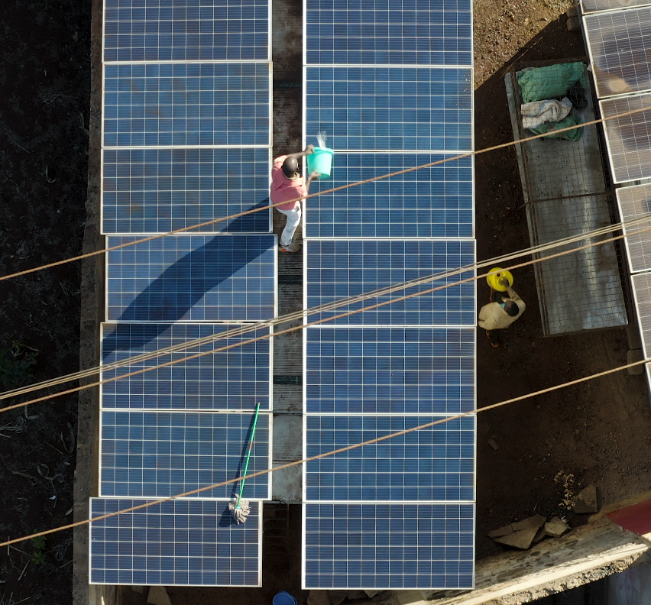





Call For Proposals 2025
Headline trends in PURE sector in sub-Saharan Africa
This material has been funded by UK aid from the UK government; however, the views expressed do not necessarily reflect the UK government's official policies.

Slide 2

613 of 732 applications passed basic eligibility checks, sought EUR 115 Mn in catalytic grants and offered EUR 73 Mn in co-financing
208804.8
209,000
186832
187,000
2

Slide 3

Significant growth in applications especially from Nigeria, Rwanda and Ghana
3

Slide 4
Agro Processing was largest sector for PURE business models
4

Slide 5
Energy for SMEs sector showed 6x rise in applications;
Growth even in traditional sectors: Solar Irrigation showed a 3x rise
5

Slide 6
89% of applicants were majority-owned by local entrepreneurs, up from 80% the previous year
6

Slide 7
Rwanda had the highest percentage of majority female-owned applications
7

Slide 8
Energy for SMEs / Businesses had the highest percentage of majority female-owned entities, and e-mobility had the lowest
8

Slide 9
84% of all applicants were for-profit entities;
38% of applicants were entities registered within the last 5 years
9

Slide 10
Percentage of PURE enterprises set up in or after 2020
10

Slide 11
More information on registration year
11

Slide 12
More information on sector distribution
Kenya: Showed the greatest sectoral mix
Nigeria: Also showed a mix, led by Agro processing at 22%
Tanzania: Clean cooking had high share
Uganda: High concentration of cooling
Zambia: was the most concentrated country with just 2 sectors taking 72% share. There was no e-mobility applicant
12

Slide 13
More information on sectors across countries
13

